Slide 1




CAST paper
2023

Slide 2

Set -B

Slide 3
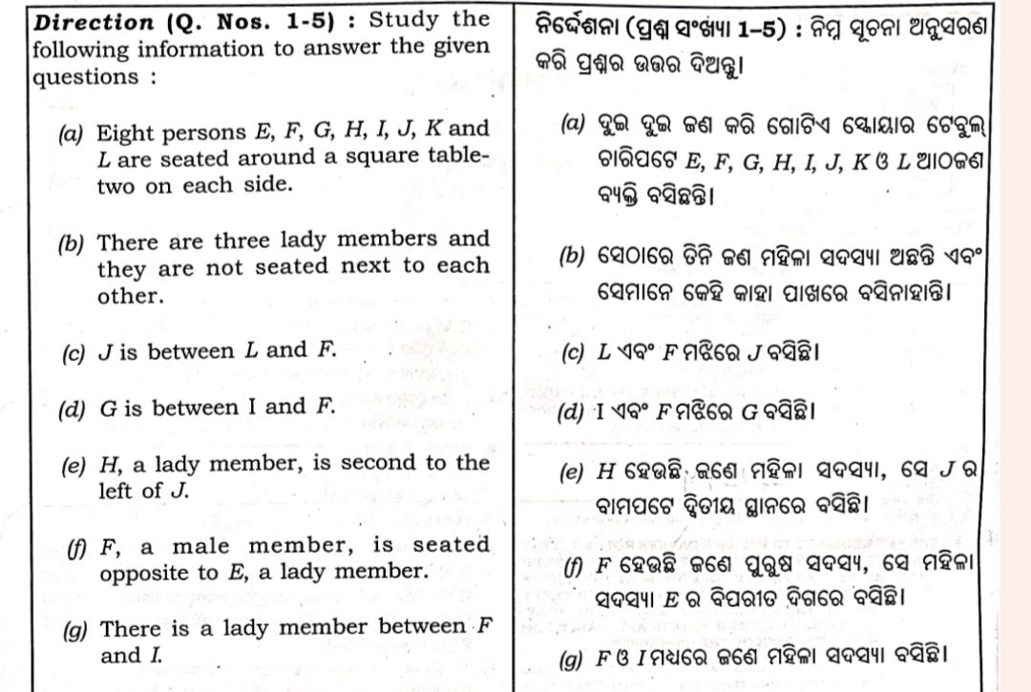

Slide 4
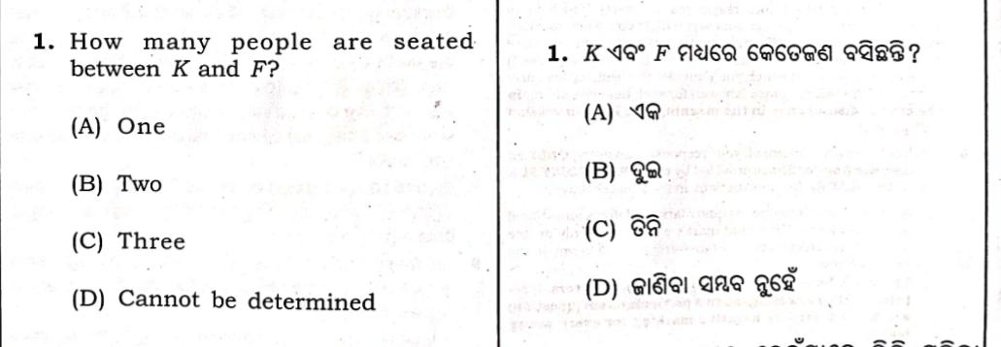
Question -1
Answer : (c)

Slide 5
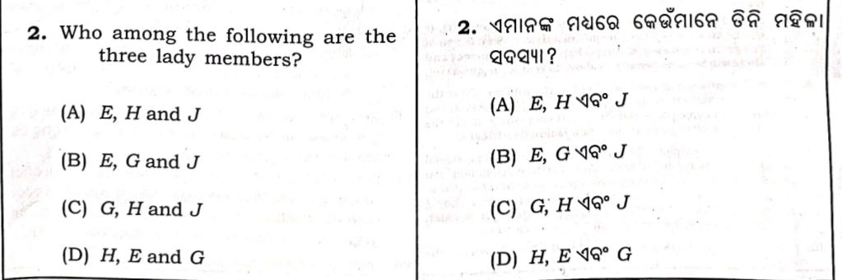
Question -2
Answer : (d)

Slide 6
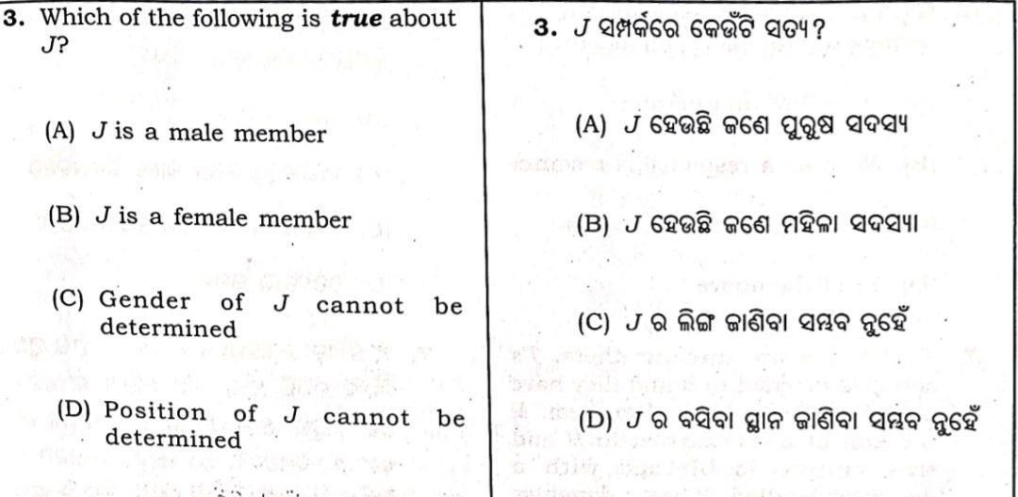
Question -3
Answer : (a)

Slide 7
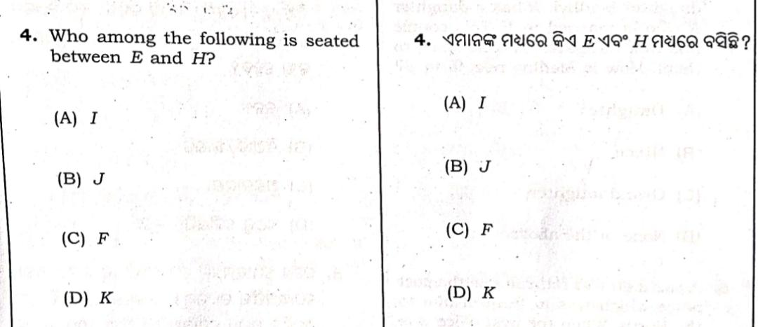
Question -4
Answer : (d)

Slide 8
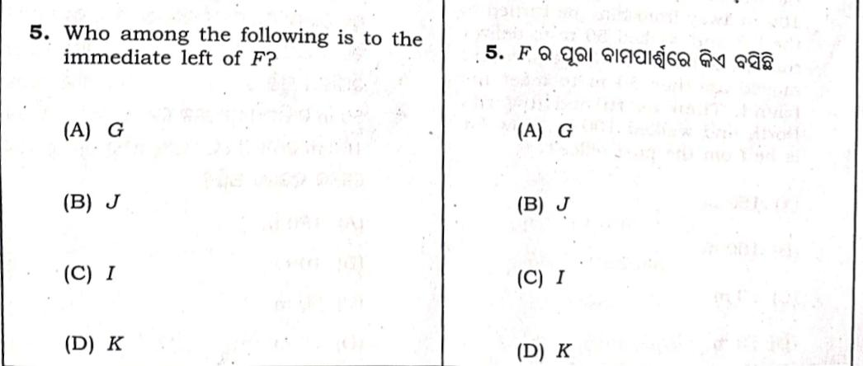
Question -5
Answer : (b)

Slide 9
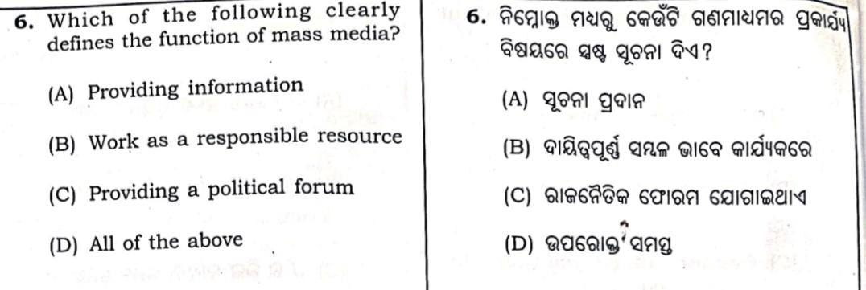
Question -6
Answer : (d)

Slide 10
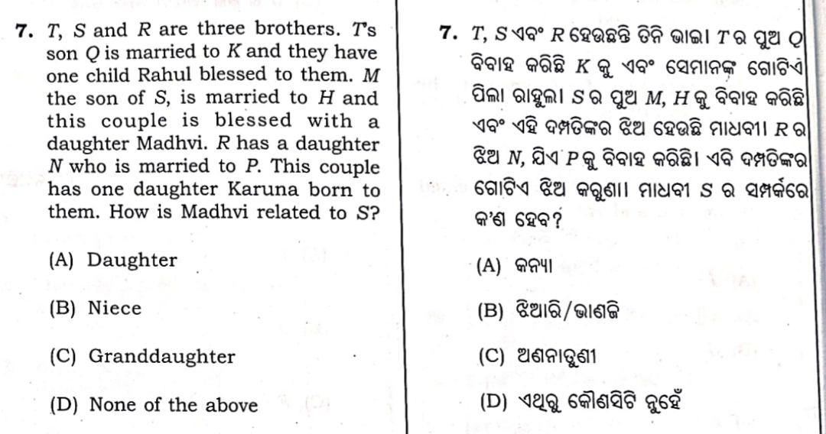
Question -7
Answer : (c)

Slide 11
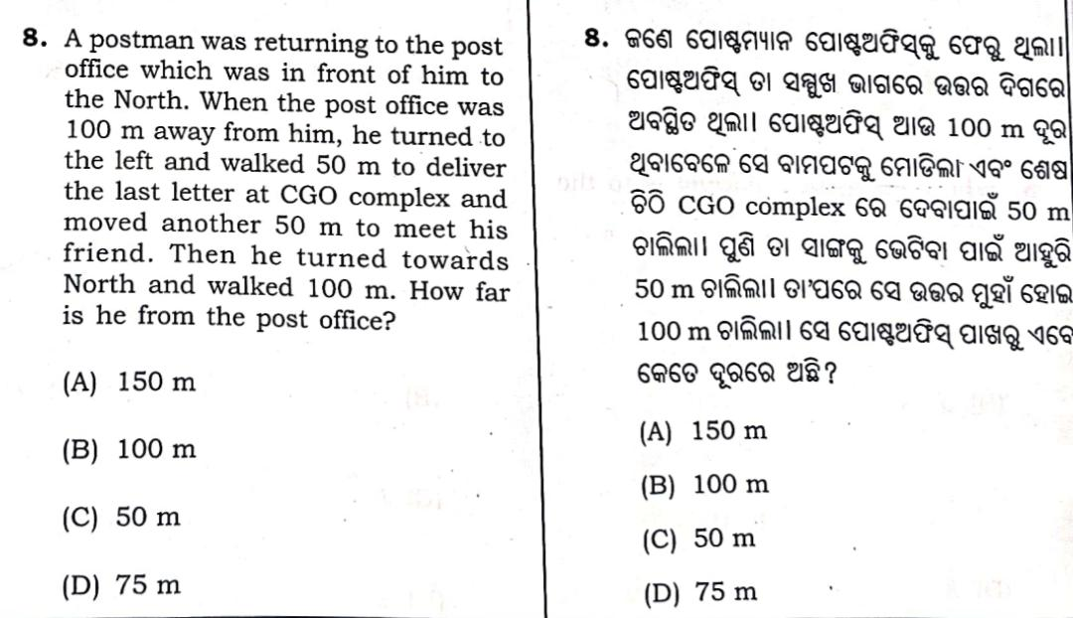
Question -8
Answer : (b)

Slide 12
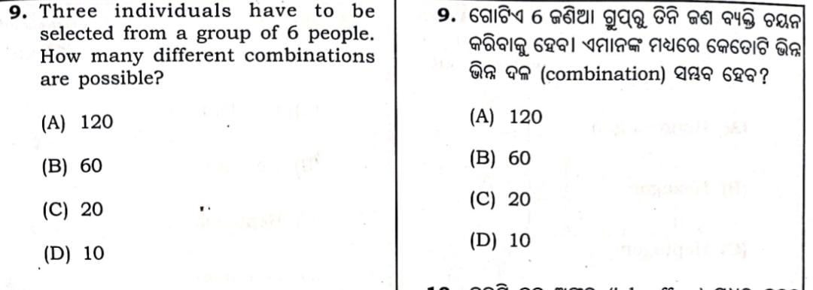
Question -9
Answer : (c)

Slide 13
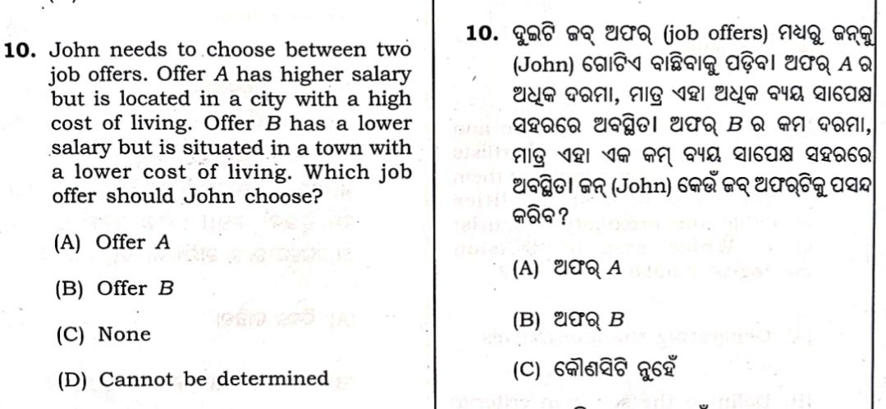
Question -10
Answer : (d)

Slide 14
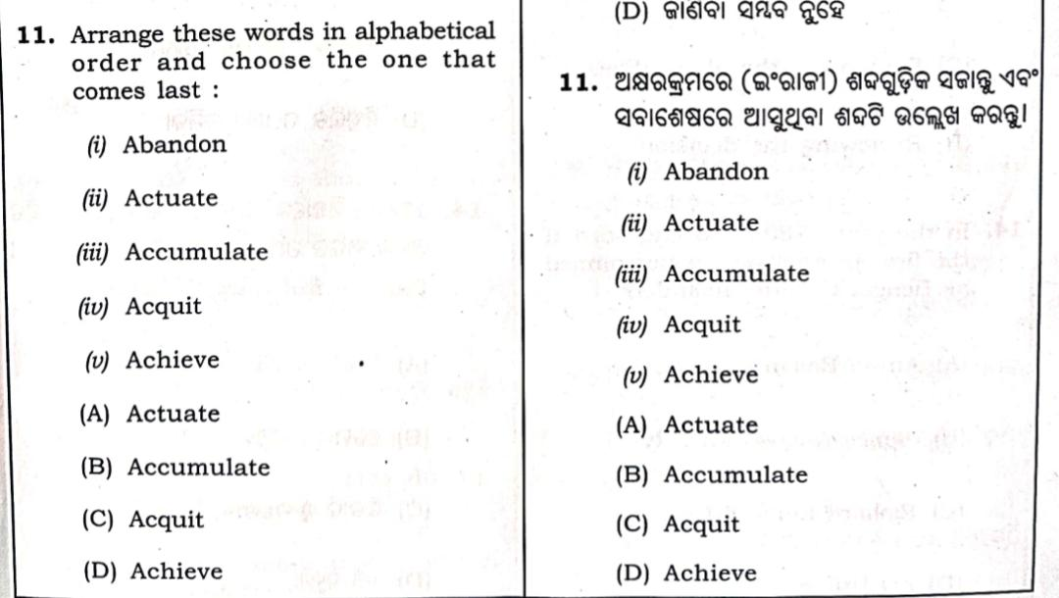
Question -11
Answer : (a)

Slide 15
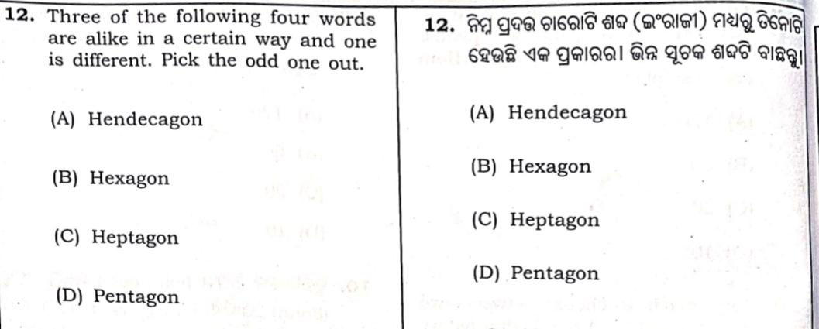
Question -12
Answer : (b)

Slide 16
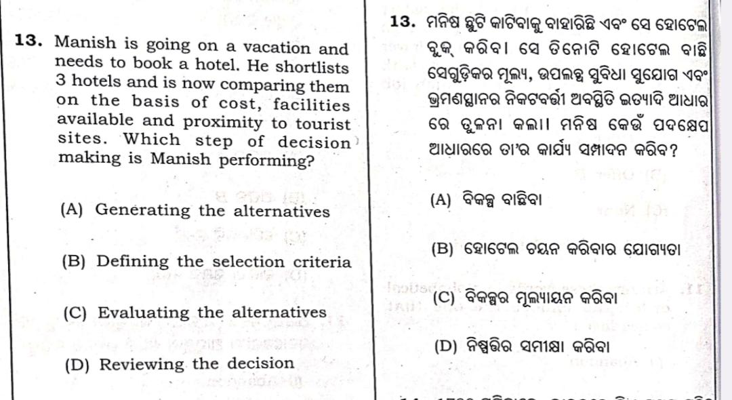
Question -13
Answer : (c)

Slide 17
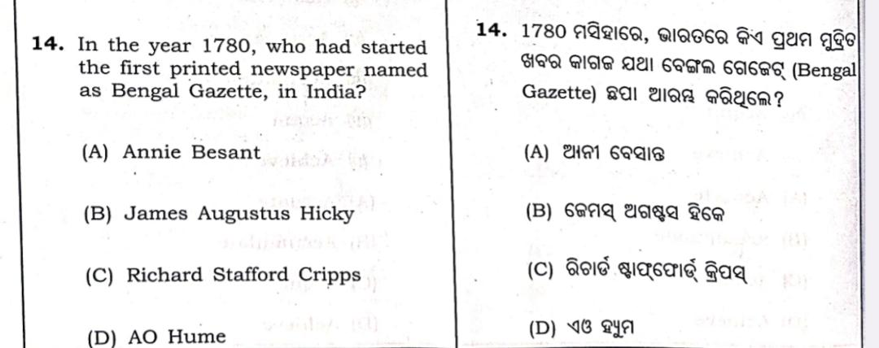
Question -14
Answer : (b)

Slide 18
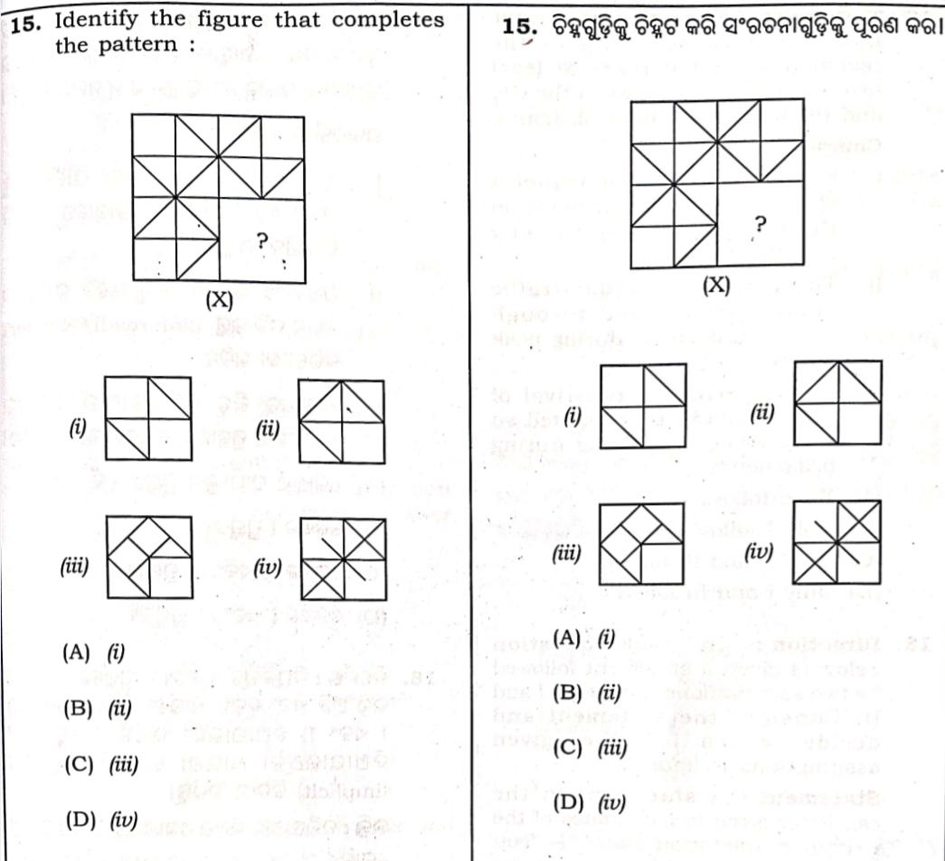
Question -15
Answer : (b)

Slide 19
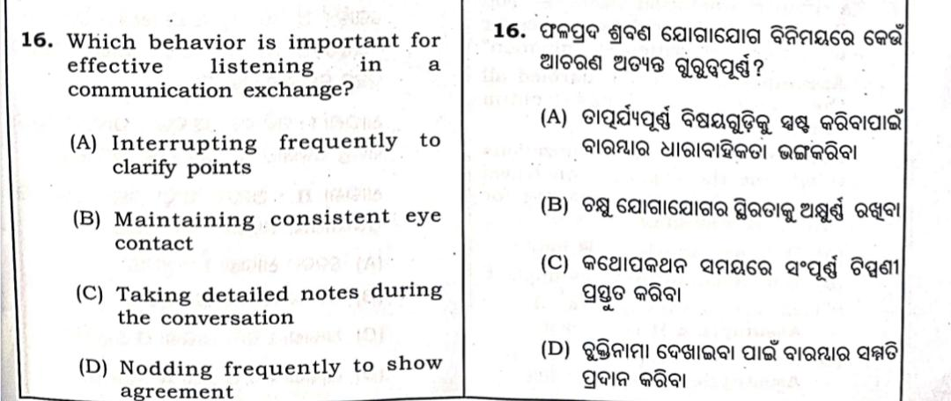
Question -16
Answer : (b)

Slide 20
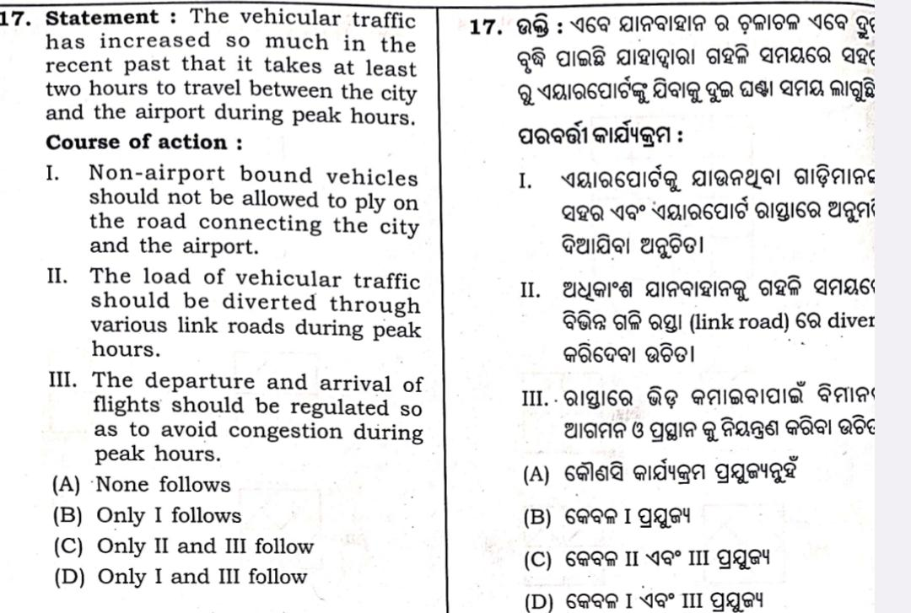
Question -17
Answer : (a)

Slide 21
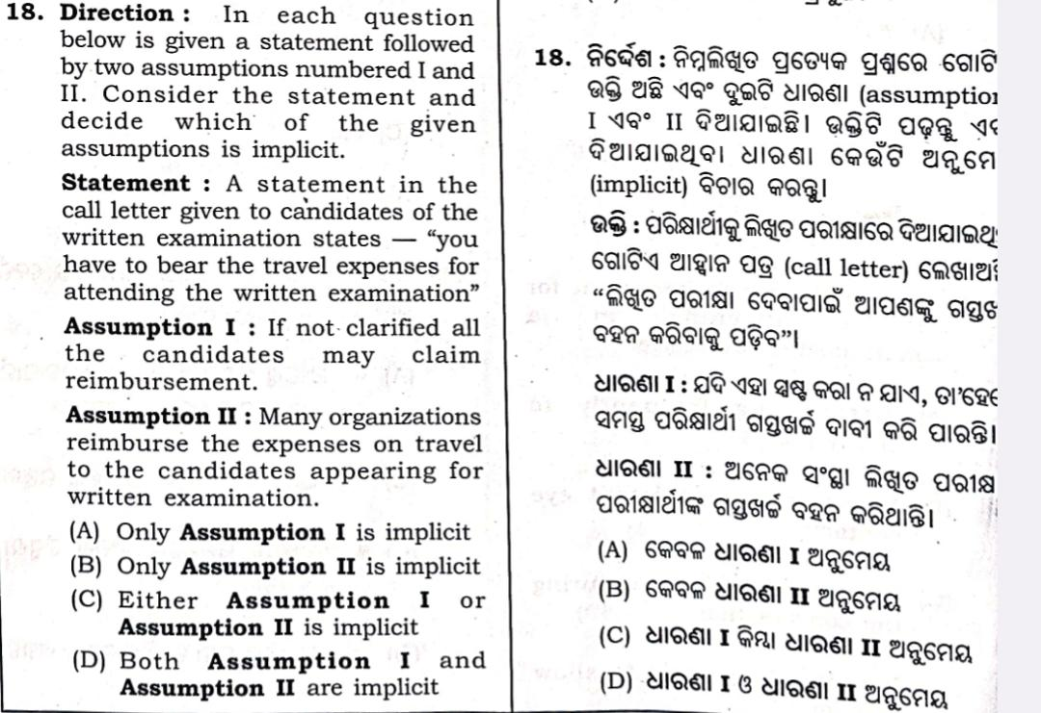
Question -18
Answer : (d)

Slide 22
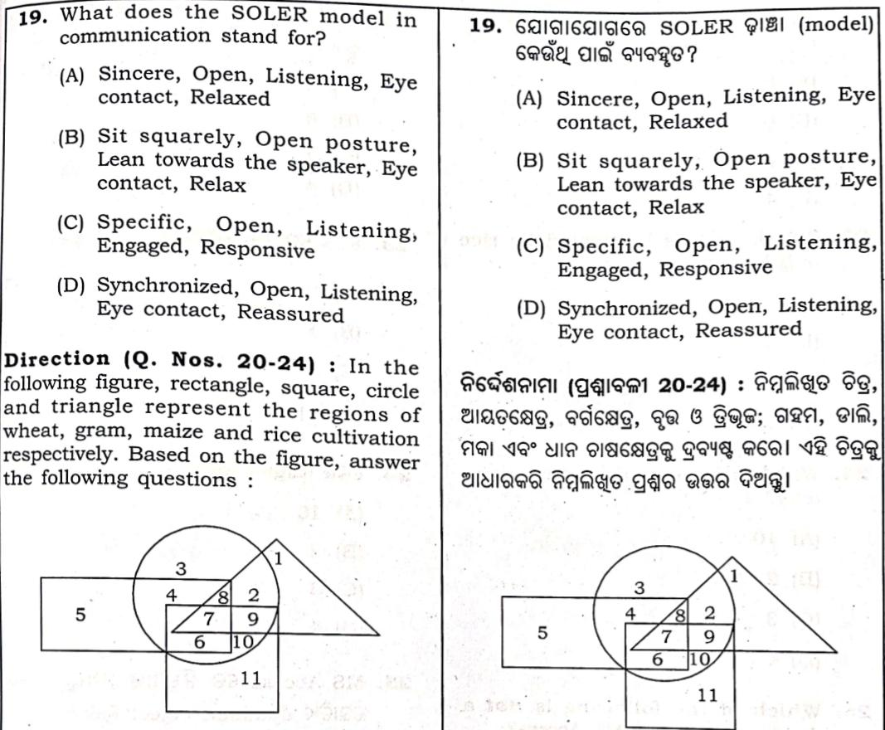
Question -19
Answer : (b)

Slide 23
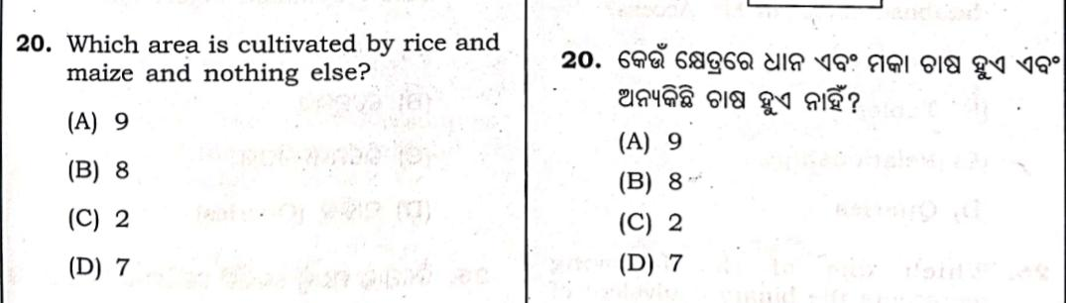
Question -20
Answer : (c)

Slide 24
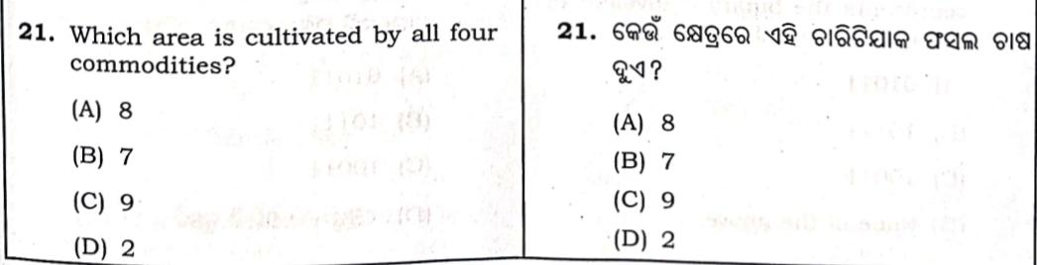
Question -21
Answer : (b)

Slide 25
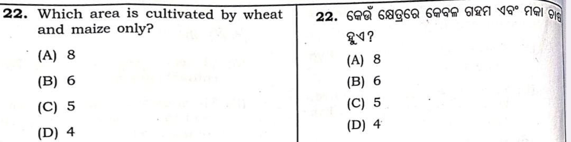
Question -22
Answer : (d)

Slide 26
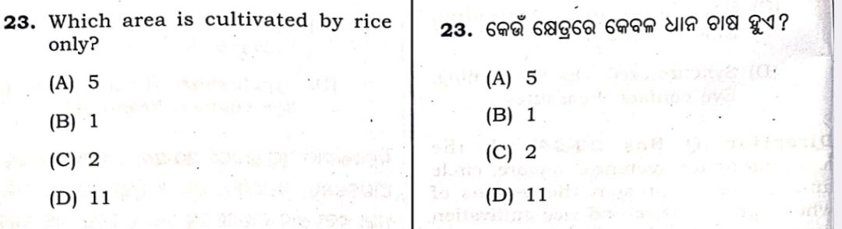
Question -23
Answer : (b)

Slide 27
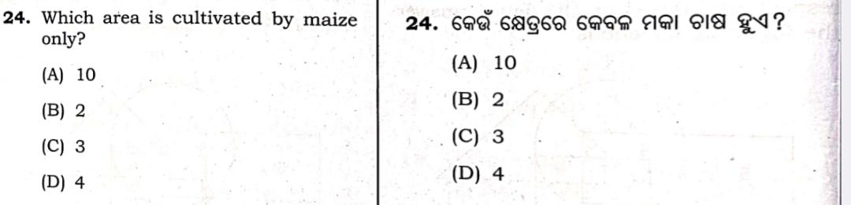
Question -24
Answer : (c)

Slide 28
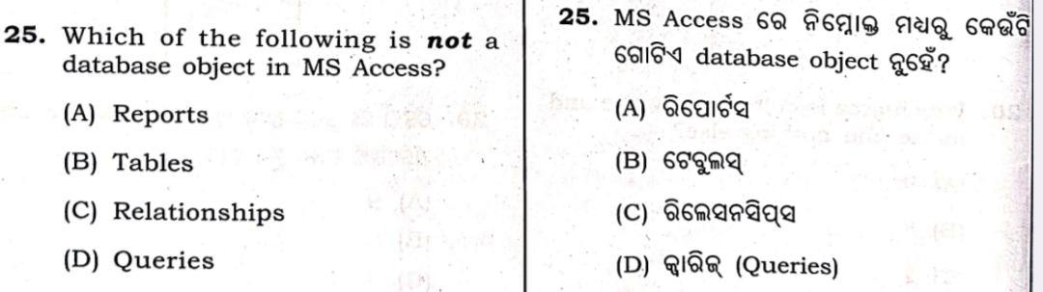
Question -25
Answer : (c)

Slide 29
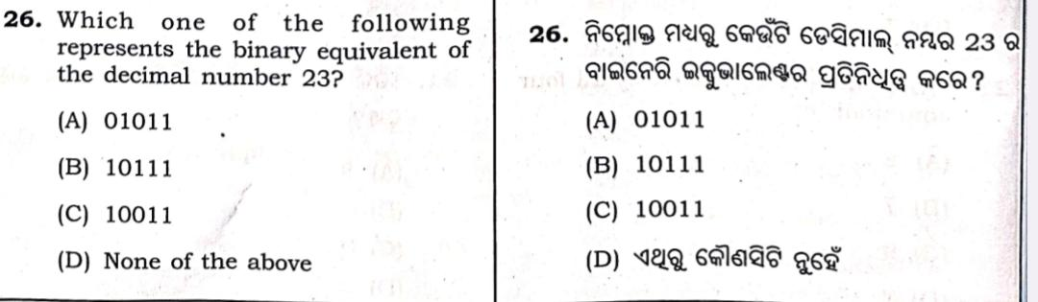
Question -26
Answer : (b)

Slide 30
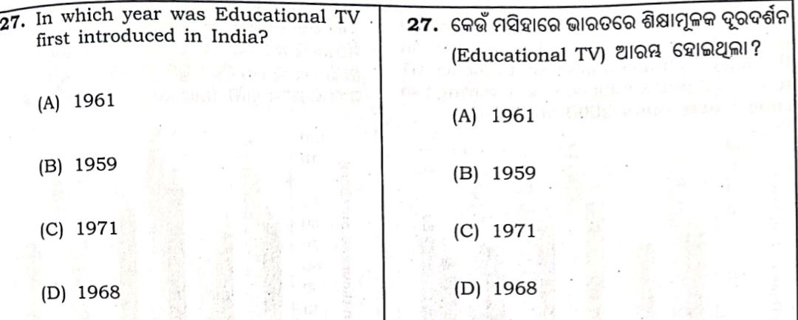
Question -27
Answer : (a)

Slide 31
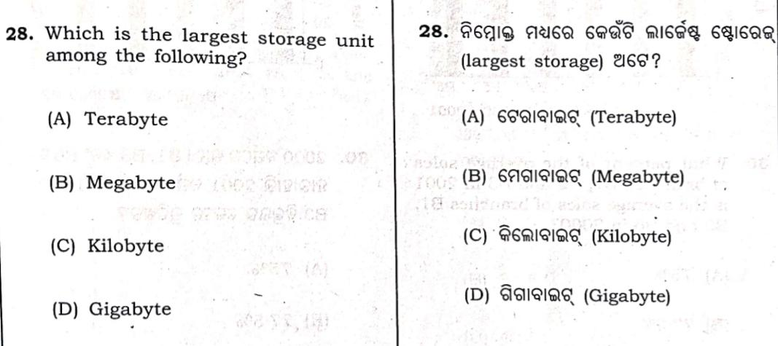
Question -28
Answer : (a)

Slide 32
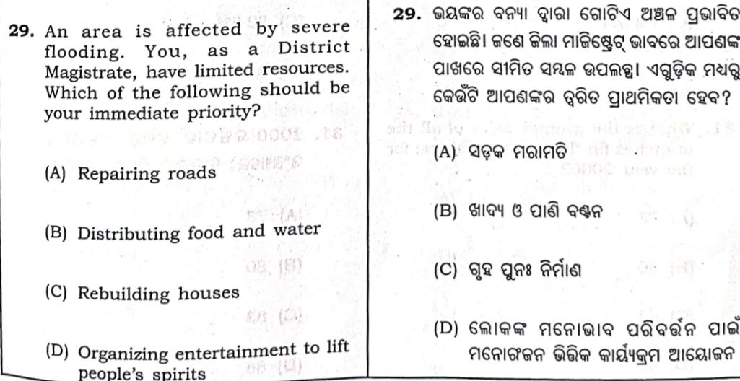
Question -29
Answer : (b)

Slide 33
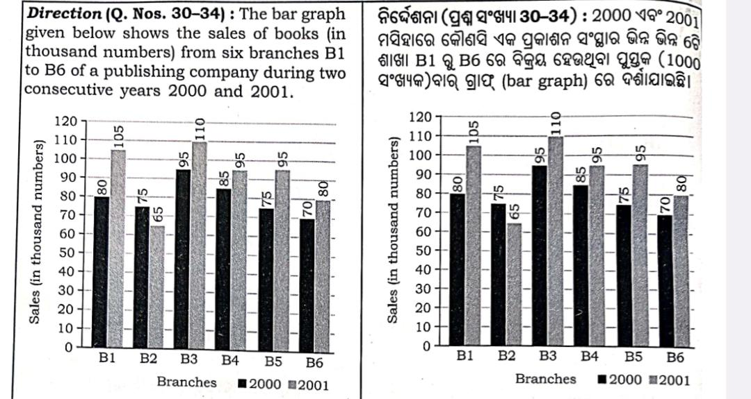

Slide 34
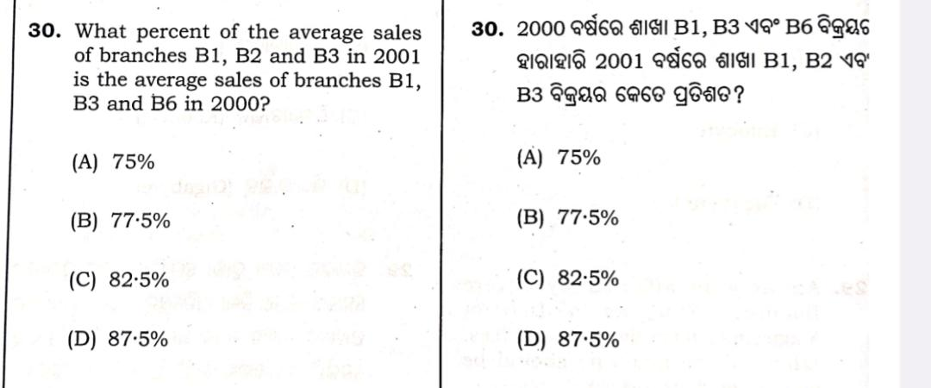
Question -30
Answer : (d)

Slide 35
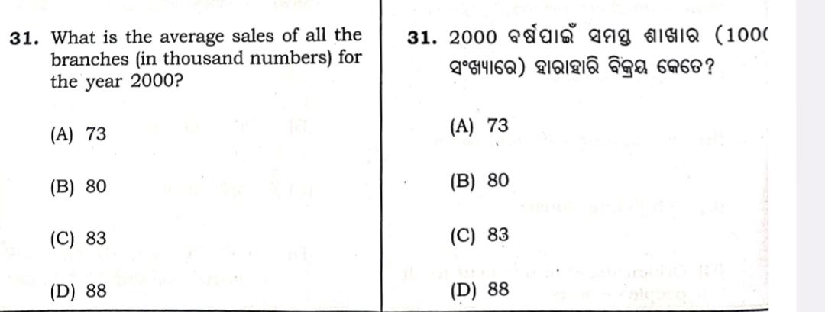
Question -31
Answer : (b)

Slide 36
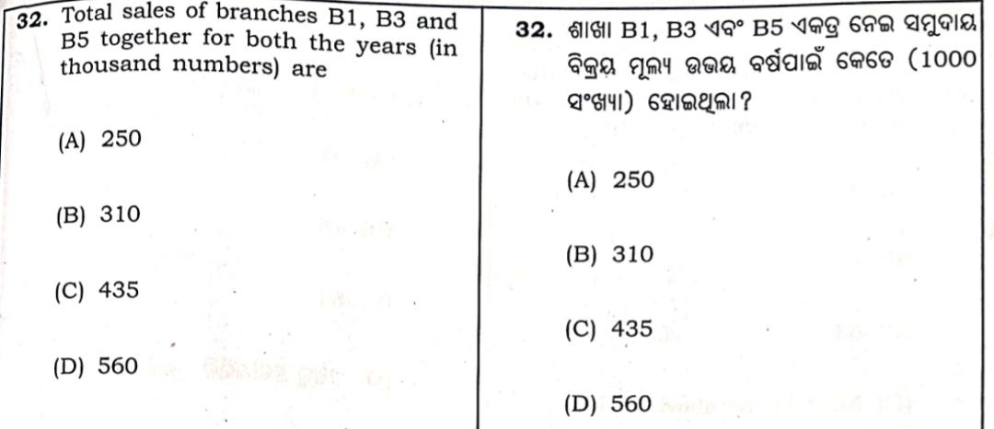
Question -32
Answer : (d)

Slide 37
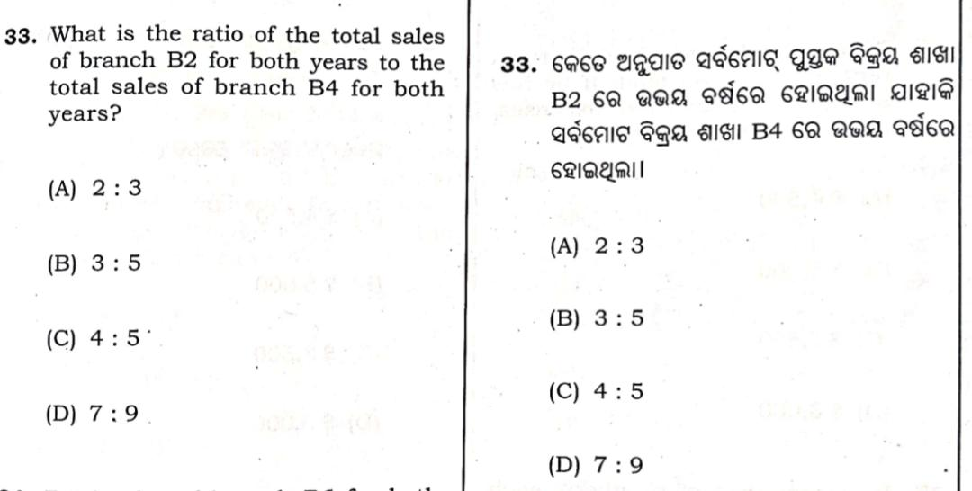
Question -33
Answer : (d)

Slide 38
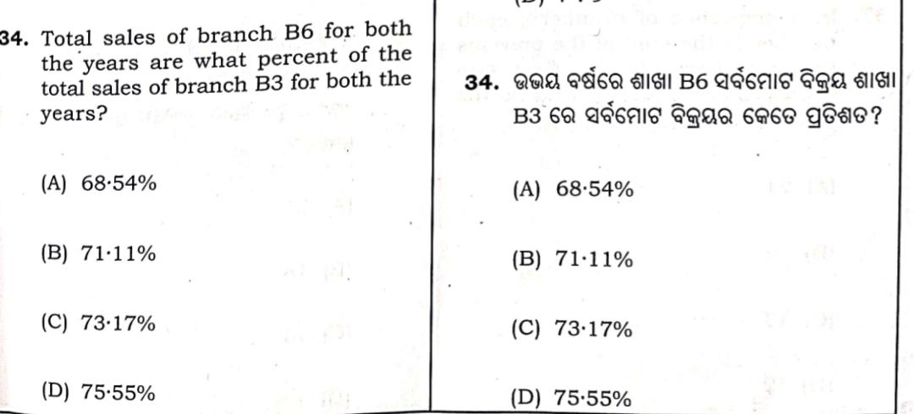
Question -34
Answer : (c)

Slide 39
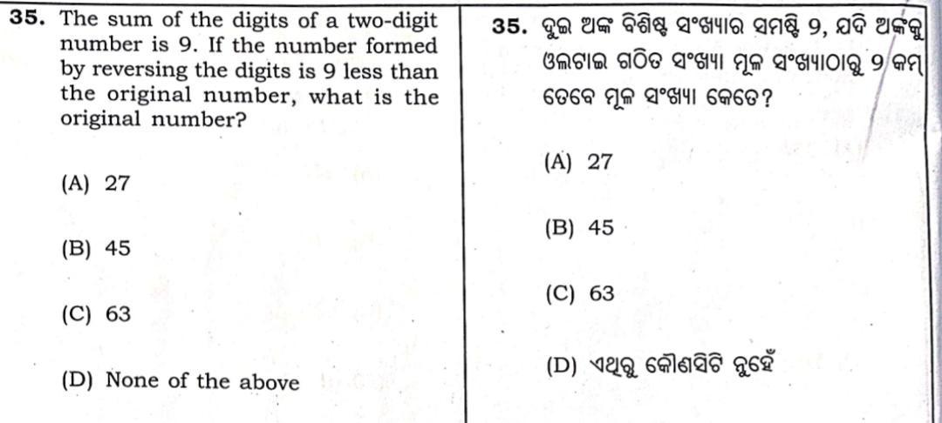
Question -35
Answer : (d)

Slide 40
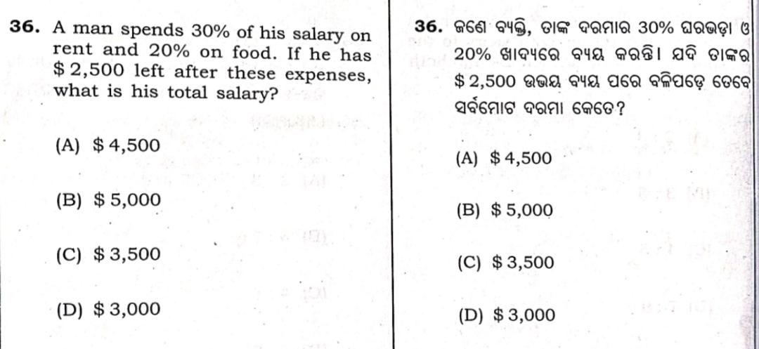
Question -36
Answer : (b)

Slide 41
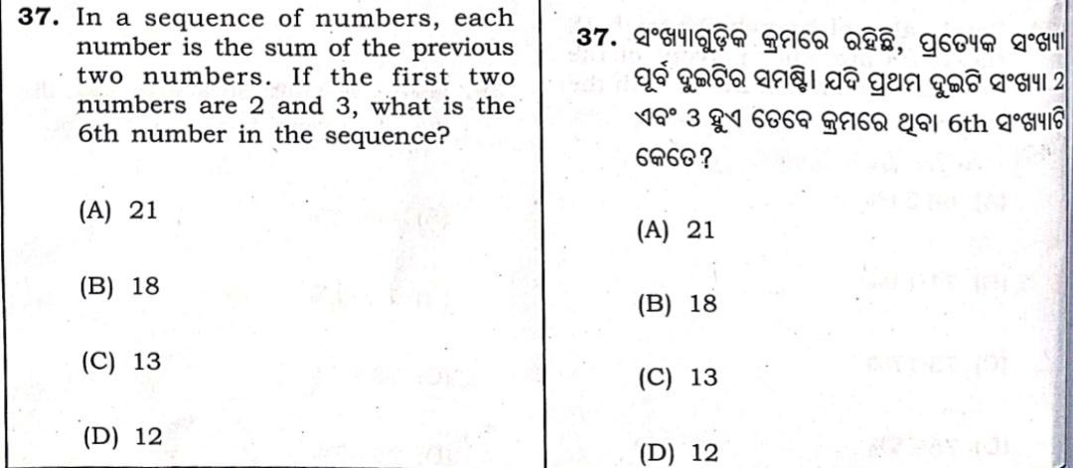
Question -37
Answer : (a)

Slide 42
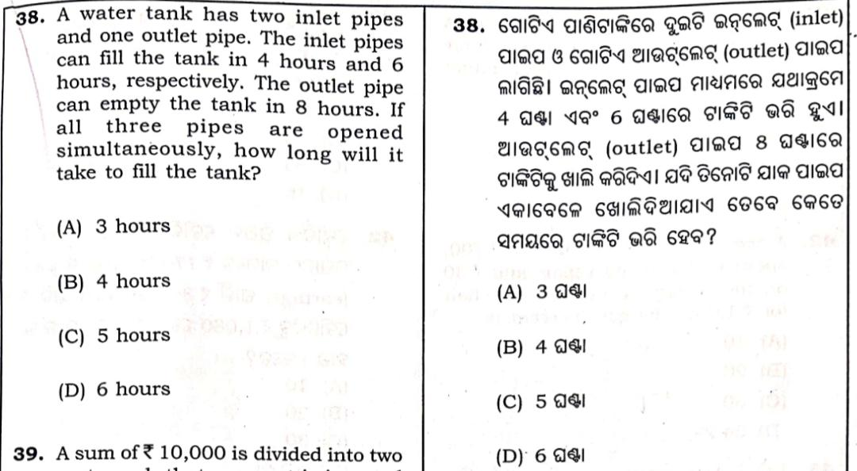
Question -38
Answer : (a /b)

Slide 43
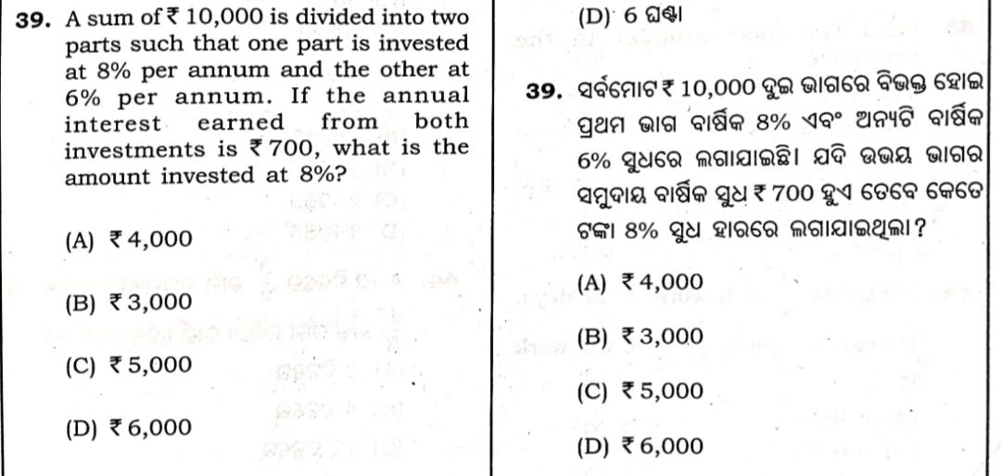
Question -39
Answer : (c)

Slide 44
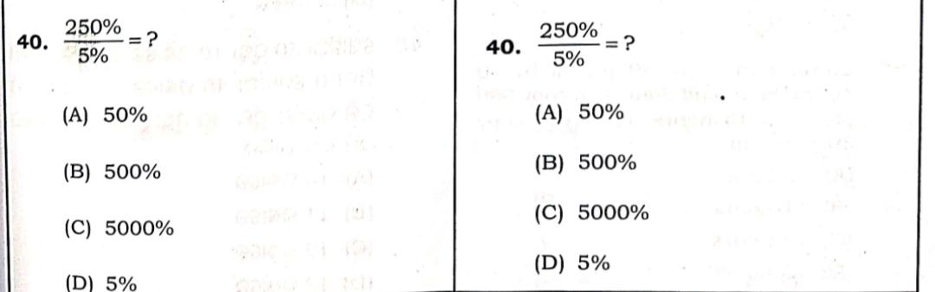
Question -40
Answer : (c)

Slide 45
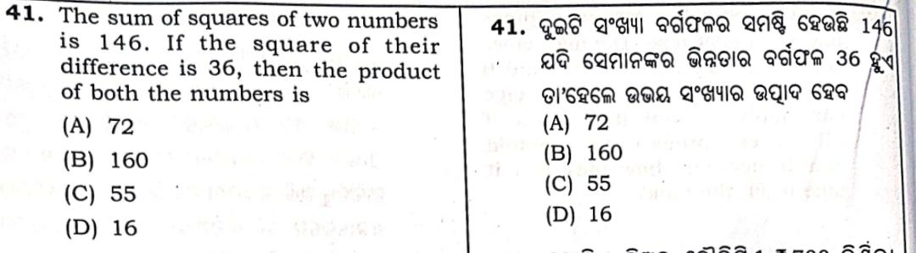
Question -41
Answer : (c)

Slide 46
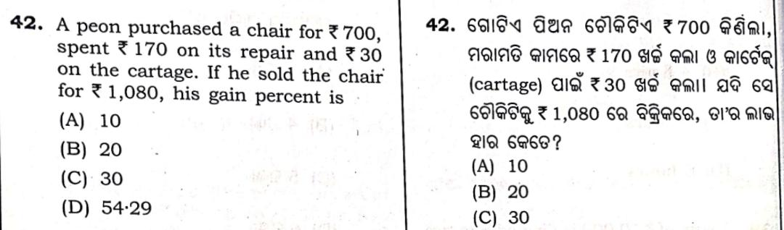
Question -42
Answer : (b)

Slide 47
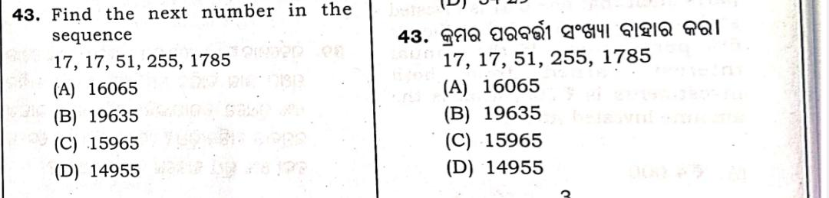
Question -43
Answer : (a)

Slide 48
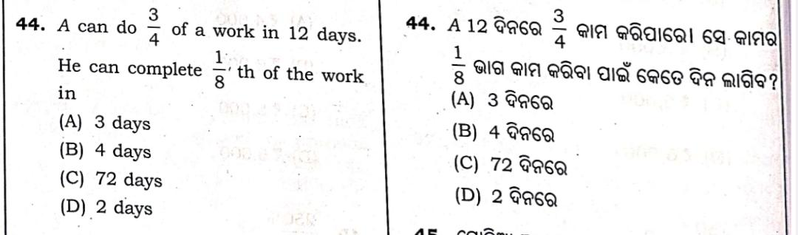
Question -44
Answer : (d)

Slide 49
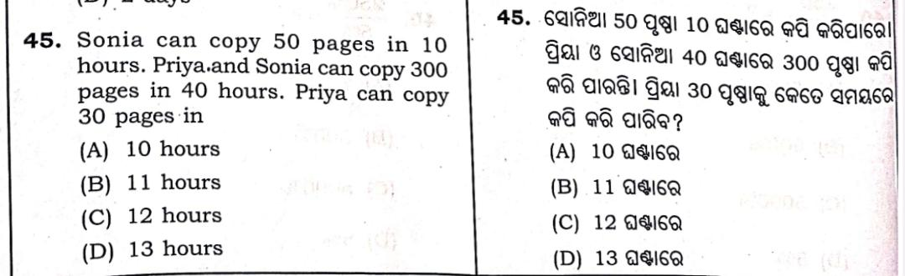
Question -45
Answer : (c)

Slide 50
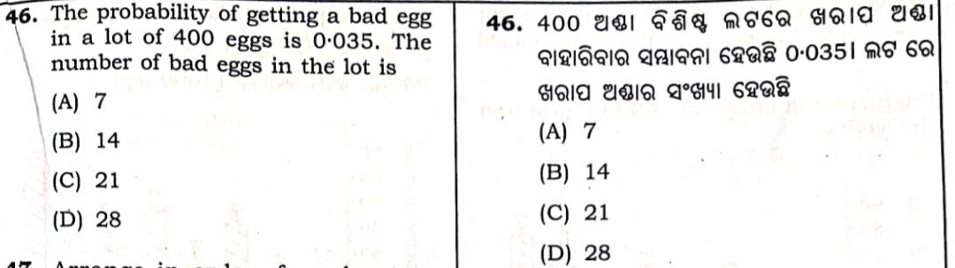
Question -46
Answer : (b)

Slide 51
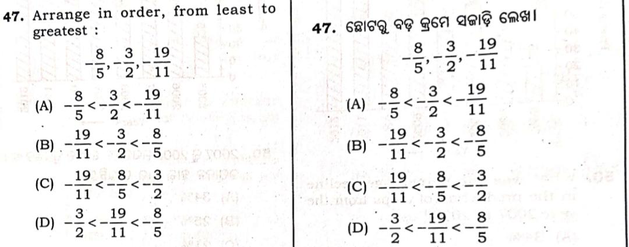
Question -47
Answer : (c)

Slide 52
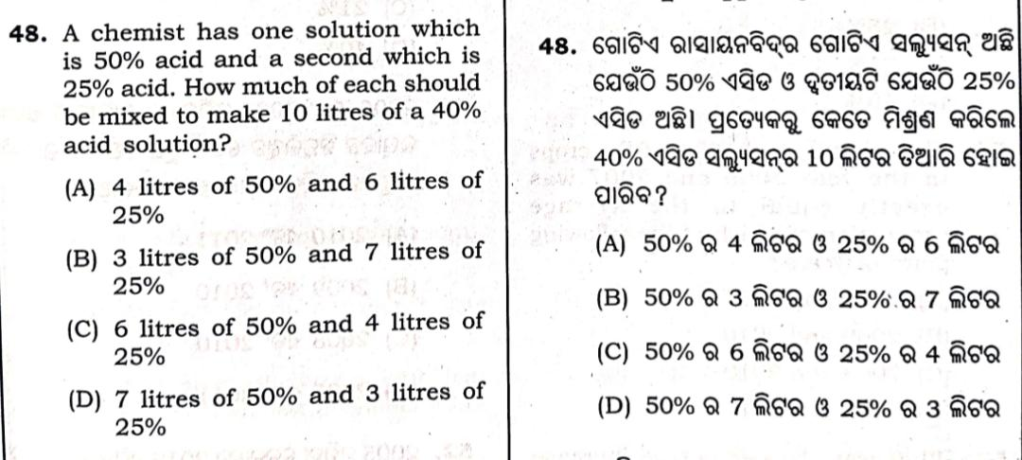
Question -48
Answer : (c)

Slide 53

Question -49
Answer : (d)

Slide 54


Slide 55

Question -50
Answer : (b)

Slide 56

Question -51
Answer : (d)

Slide 57

Question -52
Answer : (c)

Slide 58

Question -53
Answer : (a)

Slide 59

Question -54
Answer : (c)

Slide 60

Question -55
Answer : (c)

Slide 61


Slide 62

Question -56
Answer : (b)

Slide 63

Question -57
Answer : (b)

Slide 64


Slide 65

Question -58
Answer : (a)

Slide 66

Question -59
Answer : (d)

Slide 67


Slide 68


Slide 69


Slide 70

Question -60
Answer : (a)

Slide 71

Question -61
Answer : (c)

Slide 72

Question -62
Answer : (b)

Slide 73

Question -63
Answer : (b)

Slide 74

Question -64
Answer : (c)

Slide 75

Question -65
Answer : (b)

Slide 76

Question -66
Answer : (c)

Slide 77

Question -67
Answer : (b)

Slide 78

Question -68
Answer : (a)

Slide 79

Question -69
Answer : (c)

Slide 80


Slide 81

Question -70
Answer : (b)

Slide 82

Question -71
Answer : (a)

Slide 83

Question -72
Answer : (c)

Slide 84

Question -73
Answer : (c)

Slide 85

Question -74
Answer : (a)

Slide 86

Question -75
Answer : (c)

Slide 87

Question -76
Answer : (c)

Slide 88

Question -77
Answer : (b)

Slide 89

Question -78
Answer : (d)

Slide 90

Question -79
Answer : (a)

Slide 91

Question -80
Answer : (b)

Slide 92



